Slide 1


Analyzing ARP Request
Name : Shreya V
Register No : 2413421033152
Department : BCA
Year : 2024 - 2027
College Name: Shrimathi Devkunvar Nanalal Bhatt Vaishnav College for Women

Slide 2
Introduction
Wireshark is a free and open-source packet analyzer. It is used for network troubleshooting, analysis, software and communications protocol development, and education. Originally named Ethereal, the project was renamed Wireshark in May 2006 due to trademark issues. Packet is the name given to a discrete unit of data in a typical Ethernet network.
Wireshark is the most often-used packet sniffer in the world. Like any other packet sniffer, Wireshark does three things:
Packet Capture: Wireshark listens to a network connection in real time and then grabs entire streams of traffic – quite possibly tens of thousands of packets at a time.
Filtering: Wireshark is capable of slicing and dicing all of this random live data using filters. By applying a filter, you can obtain just the information you need to see.
Visualization: Wireshark, like any good packet sniffer, allows you to dive right into the very middle of a network packet. It also allows you to visualize entire conversations and network streams.
Address Resolution Protocol (ARP) The Address Resolution Protocol is a layer 2 protocol used to map MAC addresses to IP addresses. All hosts on a network are located by their IP address, but NICs do not have IP addresses, they have MAC addresses. ARP is the protocol used to associate the IP address to a MAC address.

Slide 3
Objectives
The primary objective of analyzing ARP requests using Wireshark is to understand the mapping between IP addresses (Layer 3) and MAC addresses (Layer 2) on a network, allowing you to identify active devices, troubleshoot connectivity issues, and detect potential security threats like ARP spoofing by examining the source and destination IP and MAC addresses within captured ARP packets.
Key objectives include:
Identifying network devices
Troubleshooting connectivity problems
Detecting ARP spoofing attacks
Key points to consider when analyzing ARP requests in Wireshark:
Source and destination IP addresses: Identify which devices are sending and receiving ARP requests.
Source and destination MAC addresses: Analyze the MAC addresses associated with the IP addresses involved in the ARP communication.
ARP operation type: Determine whether the packet is an ARP request or reply.
Network traffic patterns: Observe the frequency and timing of ARP requests to identify potential anomalies.

Slide 4
Literature Review
S.No | Title of the Paper | Author Name | Proposed Solution | Journal Conference Name | Year of Publication
1. | Security Analysis and Simulation Experiment of ARP Protocol Vulnerability | Tong, et.al | This paper examines ARP protocol vulnerabilities through simulation of ARP spoofing and flooding attacks, using Wireshark for analysis, and proposes preventive measures. | International Core Journal of Engineering | 2024
2. | A Strategy to Mitigate ARP Spoofing Attacks on Hypervisors | Mohamed, et.al | A study found virtual machines in a multi-tenant cloud vulnerable to ARP spoofing, with those running multiple OSes being more susceptible. A Kali Linux Python script mitigated the attacks, but no hypervisor was fully immune. | 2024 Fourth ICAECT | 2024

Slide 5
S.No | Title of the Paper | Author Name | Proposed Solution | Journal Conference Name | Year of Publication
3. | Forensic Analysis of an IoT ARP Spoofing Attack | Friedl, et.al | ARP spoofing in IoT enables hackers to steal traffic, as shown in a case of industrial espionage, emphasizing the need for forensic analysis to detect such advanced attacks. | 2024 12th ISDFS | 2024
4. | An Effective Prevention Approach against ARP Cache Poisoning Attacks in MikroTik-based Networks | Suethanuwong, et.al | This paper proposes Gateway-controlled ARP (GCA) to prevent ARP cache poisoning in MikroTik-based RoaS networks by forwarding ARP messages to the router for inspection, effectively blocking spoofed packets. | ECTI-CIT | 2024

Slide 6
S.No | Title of the Paper | Author Name | Proposed Solution | Journal Conference Name | Year of Publication
5. | Arp spoofing detection using machine learning classifiers: an experimental study | Majumder, et.al | This study develops a real-time ARP spoofing detection approach, optimizing ML classifiers for continuous IP/MAC verification, achieving 99.26% F1-Score with CNN for real-time detection. | Knowledge and Information Systems | 2025

Slide 7
Installation and Setup
Install Wireshark:
Download and install Wireshark from Wireshark's official website.
Follow the installation process for your operating system (Windows, Linux, macOS).
Set Up Network Interfaces:
Ensure Wireshark is running with the necessary privileges to capture network traffic.
Select the correct network interface (Ethernet, Wi-Fi, etc.) that you want to monitor.

Slide 8
Analyzing Captured Data
Start Capturing Packets:
Open Wireshark and choose the network interface to capture traffic from.
Click on the "Start Capturing Packets" button (the shark fin icon).
2. Filter Traffic (Optional):
You can apply filters to capture only relevant traffic, such as:
http for HTTP traffic.
dns for DNS queries.
arp
3. Load the Captured Data
Open the capture file in Wireshark or another packet analysis tool.
4. Analyze ARP Requests and Replies
Look for normal ARP requests, which ask for MAC addresses (e.g., "Who has 192.168.1.1? Tell 192.168.1.100").

Slide 9
Applying Filters / Intercepting & Modifying Requests
1. Applying Filters for ARP Traffic
Filtering ARP packets helps focus on specific network interactions.
Wireshark Filters
Capture Filter: To capture only ARP packets
Display Filter: To analyze ARP traffic after capture

Slide 10
Cyber law
ARP spoofing or attacks that modify network traffic are illegal in India under cybercrime laws. The IT Act, 2000, and Indian Penal Code (IPC) cover such offenses.
Key Laws & Punishments
Unauthorized Access & Hacking (IT Act, Sec 43, 66)
Modifying network traffic without permission is illegal.
Punishment: Up to 3 years jail or ₹5 lakh fine.
Identity Theft & Fraud (IT Act, Sec 66B, 66C, 66D)
Using ARP spoofing to steal data or impersonate someone is punishable.
Punishment: Up to 3 years jail and fines.
Privacy Violation (IT Act, Sec 72)
Stealing private data via ARP attacks is a crime.
Punishment: Up to 2 years jail or fine.
Financial Fraud (IPC Sec 420)
If ARP spoofing is used for scams, fraud laws apply.
Punishment: Up to 7 years jail.

Slide 11
Case Study of Wireshark
Case Title: Detecting and Mitigating ARP Spoofing in a Corporate Network
Background
A mid-sized company with 200+ employees started experiencing intermittent network slowdowns and unauthorized access attempts. The IT team suspected a potential security threat but lacked concrete evidence. They decided to use Wireshark to analyze ARP traffic and identify anomalies.
Objectives
Capture and analyze ARP traffic to detect unusual patterns.
Identify signs of ARP spoofing or unauthorized devices.
Implement security measures based on findings.
Methodology
1. Capturing ARP Traffic Using Wireshark
The IT team ran Wireshark on a mirrored switch port to capture all ARP requests and replies.
Filter applied: The capture was run for 24 hours during business operations.
2. Key Observations from Wireshark Analysis
(a) High Frequency of ARP Requests
The network exhibited an unusually high volume of ARP requests.
Certain IP addresses were repeatedly requesting MAC addresses, which could indicate an attack or misconfiguration.

Slide 12
b) Duplicate ARP Replies from Different MAC Addresses
Wireshark revealed multiple ARP replies for the same IP address but from different MAC addresses, indicating possible ARP spoofing.
(c) Presence of Gratuitous ARP (GARP) Packets
A rogue device was sending unsolicited ARP replies, attempting to redirect traffic.
(d) Network Slowdown Correlation
The periods of high ARP traffic aligned with users reporting slow network speeds and dropped connections.
Findings and Analysis
ARP Spoofing Detected: A rogue device was impersonating the default gateway (192.168.1.1), attempting to intercept traffic (Man-in-the-Middle attack).
Potential Data Interception: The attacker could have been sniffing sensitive employee credentials.
Network Performance Issues: The excess ARP traffic led to network congestion.
Mitigation Measures Implemented
Implemented Dynamic ARP Inspection (DAI)
The IT team enabled DAI on the core switch, preventing unauthorized ARP replies.
Configured Static ARP Entries for Critical Devices
Critical network devices (gateway, DNS server) were assigned static ARP entries to prevent spoofing.
Used ARPWatch for Continuous Monitoring
ARPWatch was deployed to log ARP changes and alert the IT team of anomalies.
Blocked Rogue MAC Address
The rogue MAC address identified in Wireshark was blacklisted on the switch.
User Awareness Training
Employees were informed about phishing attacks that could be linked to ARP spoofing.

Slide 13
Results & Impact
Reduced ARP Traffic: After implementing security measures, ARP request volume normalized. Prevented Further Attacks: No more unauthorized ARP replies were observed. Improved Network Performance: Users reported faster network speeds and fewer connection issues. Enhanced Security Monitoring: Real-time alerts were set up to detect future ARP anomalies.

Slide 14
Integration with Other Tools

Slide 15
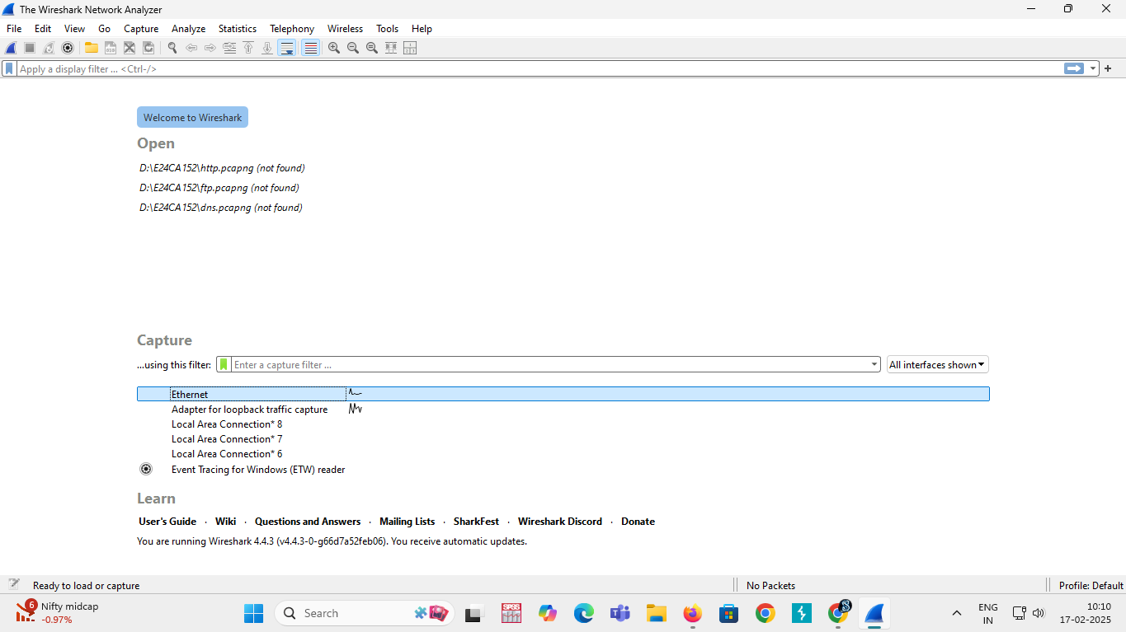
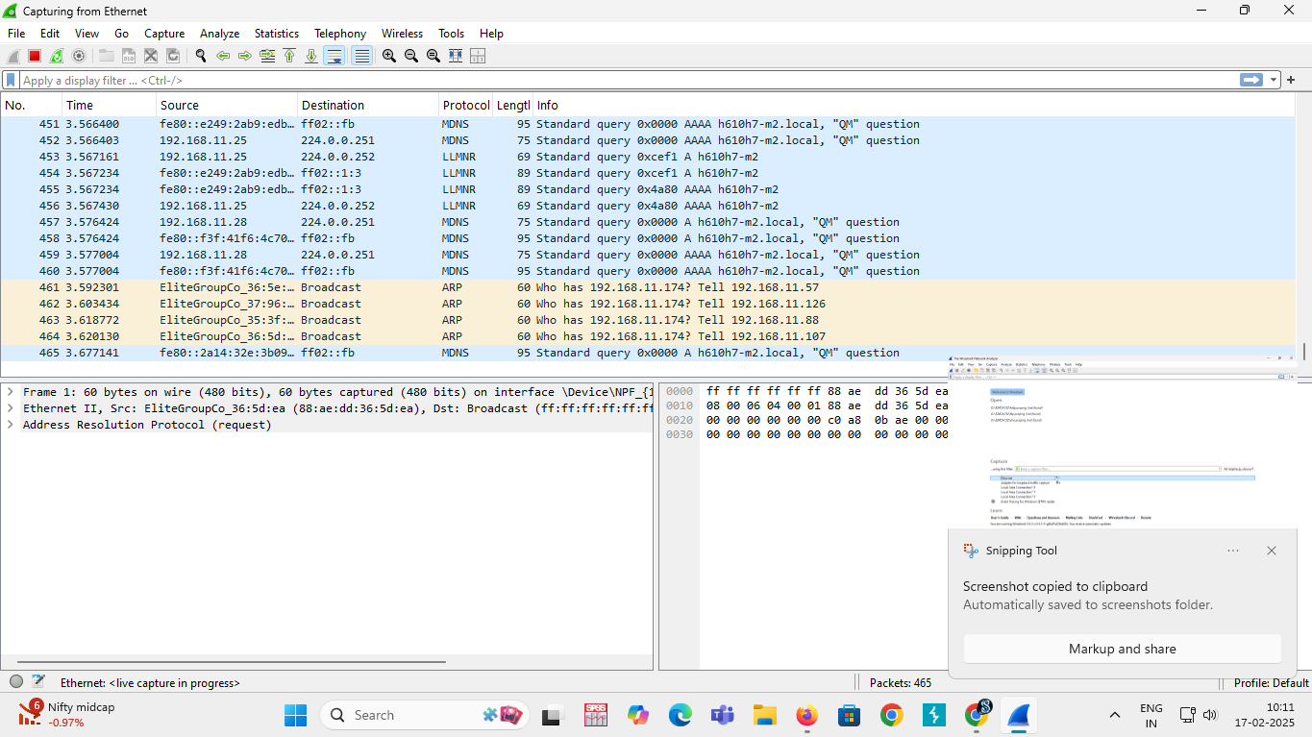
Screenshots

Slide 16
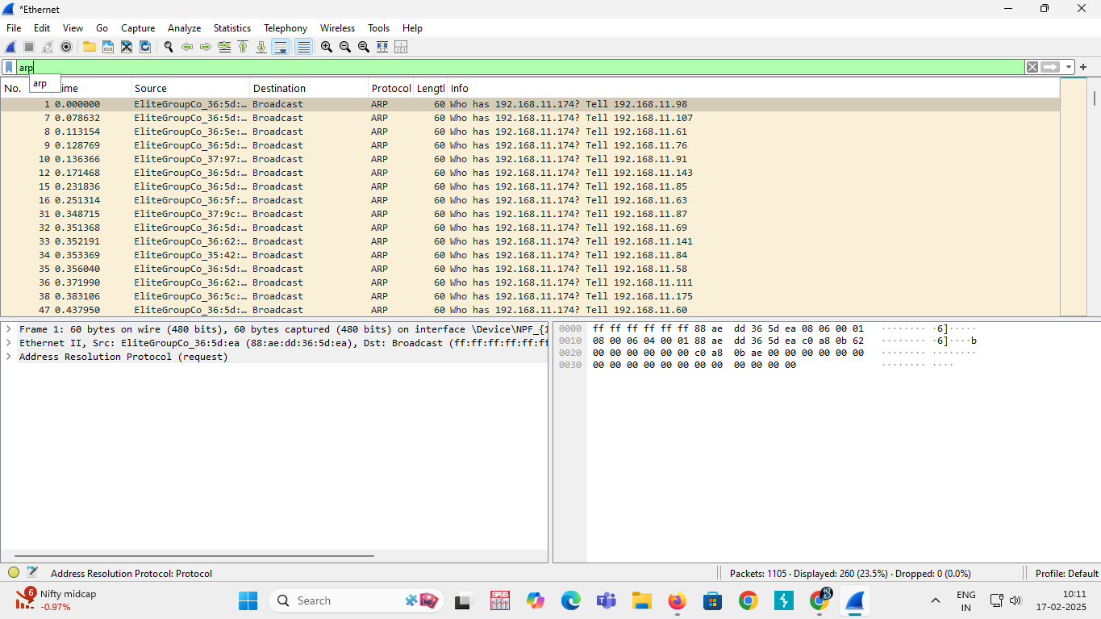
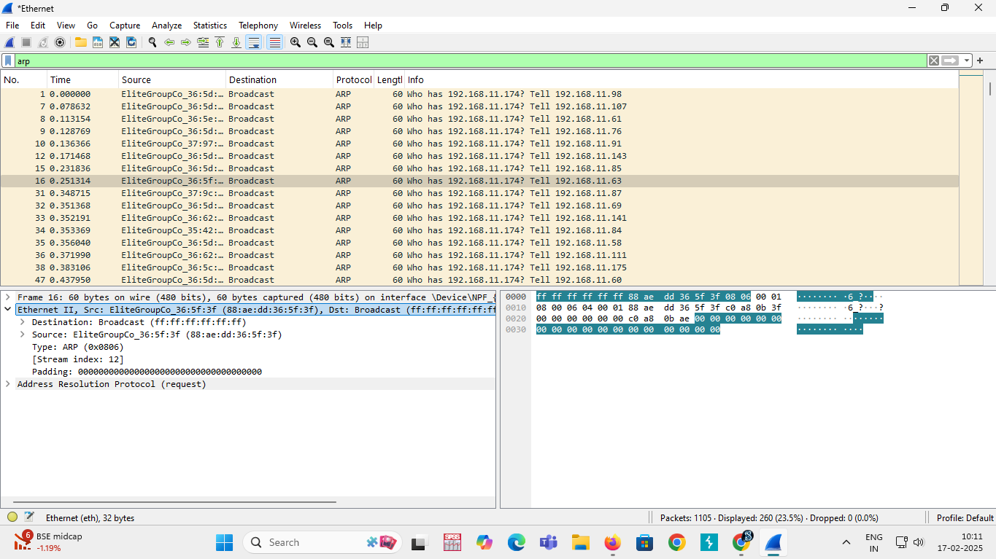
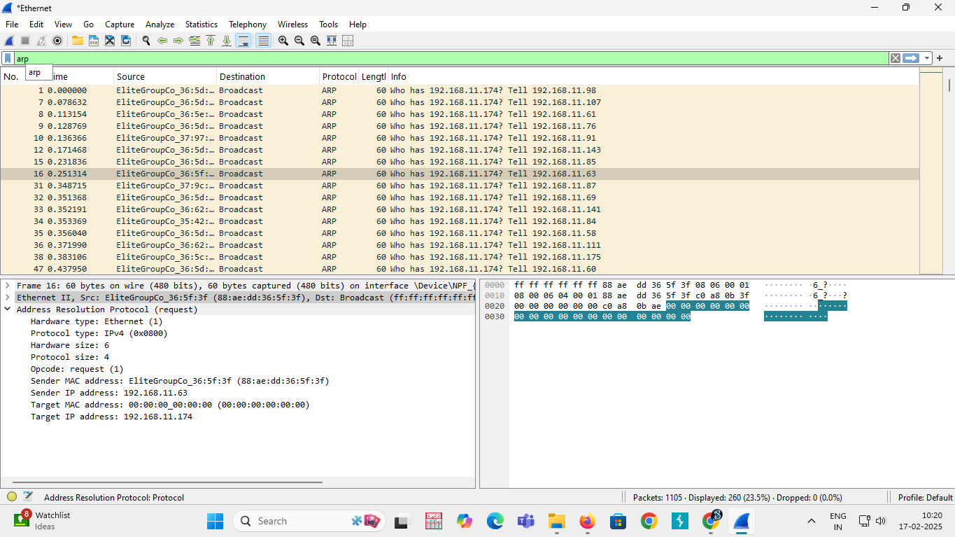
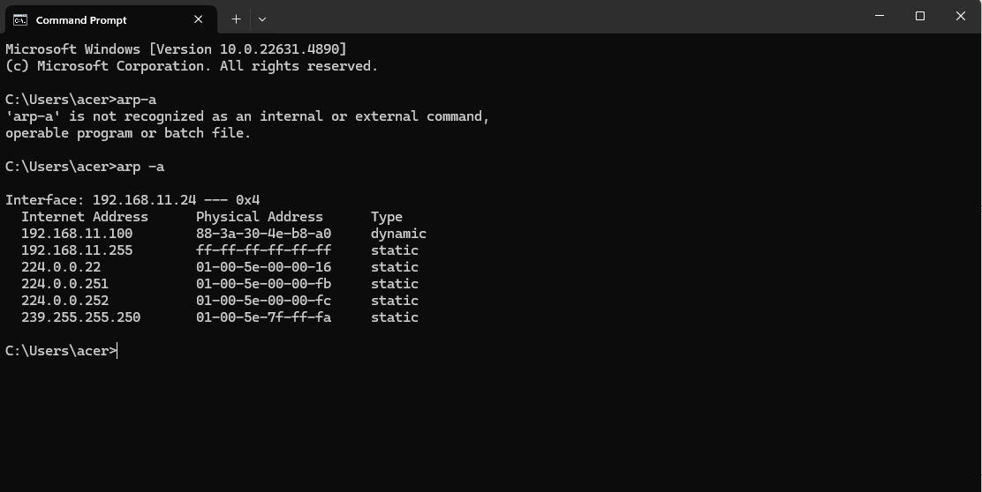

Slide 17
Challenges and Limitations
1. High Volume of ARP Traffic
Large networks generate excessive ARP requests, making it difficult to filter relevant data.
Broadcast-heavy ARP traffic can clutter packet captures, leading to analysis fatigue.
2. Short ARP Cache Lifespan
ARP cache timeout varies across devices, leading to frequent re-resolution of addresses.
Short cache durations increase the volume of ARP requests, making long-term trend analysis challenging.
3. Limited Visibility in Switched Networks
Wireshark only captures packets visible to the interface it is running on.
In a switched environment, ARP requests from other VLANs or network segments remain unseen unless configured with port mirroring or network taps.
4. Incomplete ARP Responses
Some ARP requests go unanswered, making it difficult to determine whether a device is offline, misconfigured, or blocking responses.
DHCP-based dynamic addressing can cause inconsistencies in request-response tracking.

Slide 18
Key Findings and Insights
Frequent ARP Requests:
A significant number of ARP requests were observed, indicating active device discovery and address resolution on the network.
High-frequency ARP traffic may suggest network congestion or inefficient ARP handling.
Broadcast Traffic Dominance:
Most ARP requests are broadcasted (sent to MAC address FF:FF:FF:FF:FF:FF), which can lead to increased network load if unmanaged.
Unresolved ARP Requests:
Some ARP requests remain unanswered, potentially indicating inactive devices, misconfigured hosts, or security concerns like IP conflicts.

Slide 19
Conclusion
Analyzing ARP requests using Wireshark provides valuable insights into network activity, security threats, and performance issues. The findings from the analysis help identify network inefficiencies, unauthorized devices, and potential cyber threats such as ARP spoofing and Man-in-the-Middle attacks.
Wireshark proved to be a critical tool in identifying ARP spoofing and network inefficiencies. The insights gained helped the company secure its network and improve performance through better ARP management.

Slide 20
References
Tong, H., Zhou, G., & Liu, S. (2024). Security Analysis and Simulation Experiment of ARP Protocol Vulnerability. International Core Journal of Engineering, 10(1), 288-294.
Friedl, S., & Pernul, G. (2024, April). Forensic Analysis of an IoT ARP Spoofing Attack. In 2024 12th International Symposium on Digital Forensics and Security (ISDFS) (pp. 1-7). IEEE.
Mohamed, Y. A., Hashim, M., & Bashir, M. (2024, January). A Strategy to Mitigate ARP Spoofing Attacks on Hypervisors. In 2024 Fourth International Conference on Advances in Electrical, Computing, Communication and Sustainable Technologies (ICAECT) (pp. 1-8). IEEE.
Suethanuwong, E. (2025). An Effective Prevention Approach against ARP Cache Poisoning Attacks in MikroTik-based Networks. ECTI Transactions on Computer and Information Technology (ECTI-CIT), 19(1), 1-12.
Majumder, S., Deb Barma, M. K., & Saha, A. (2025). Arp spoofing detection using machine learning classifiers: an experimental study. Knowledge and Information Systems, 67(1), 727-766.

